Slide 1
TWEETS’ EXPLORATION FROM INDONESIAN NETIZENS ON TWITTER WITH DATA SCIENCE
IRFAN HARI ISPANDANA
BINAR ACADEMY
DATA SCIENCE – WAVE 16
Data Preprocessing
Data Analysis (Descriptive Analysis)
Data Visualization

Slide 2
BACKGROUND OF THE RESEARCH
Are you individuals who use social media, or are you referred to as 'Netizens,' particularly on Twitter? If yes, you are one of Indonesia's 18.45 million 'Netizens' (source: dataindonesia.id).
In this study, I will investigate tweets in Indonesia with the help of utilizing Data Science and technologies such as Python, Jupyter Notebook and Visual Studio Code. I'll be conducting data cleaning, descriptive analysis, and displaying descriptively analyzed data.
This study is based on a data set obtained from https://www.kaggle.com/datasets/ilhamfp31/indonesian-abusive-and-hate-speech-twitter-text and the original author's GitHub repository: https://github.com/okkyibrohim/en-multi-label-hate-speech-and-abusive-language-detection. This information was compiled in 2019.

Slide 3



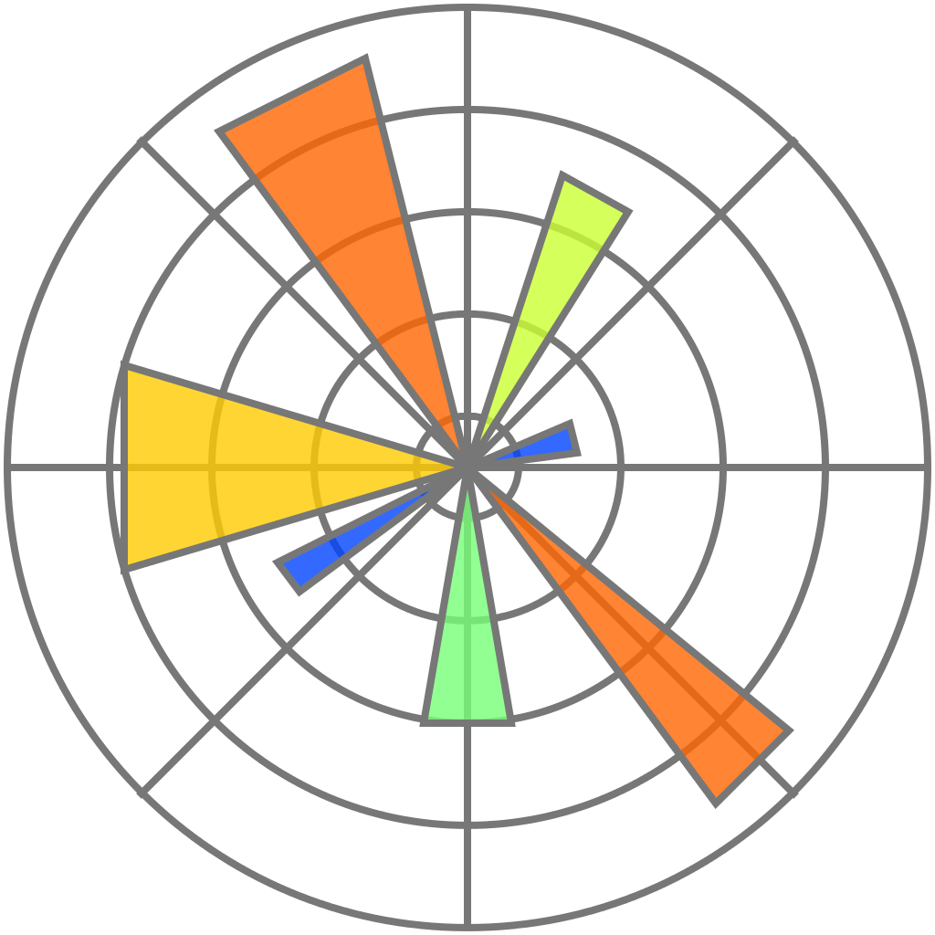


RESEARCH METHODS
In this study, I used descriptive analysis to analyze text data
Data Visualization using Pandas, Matplotlib, and Word Cloud.
Data Analysis using descriptive statistics (Univariate and Bivariate).
Data Preprocessing (Data Cleaning) using Pandas, RegEx, and NLTK.
Tools and libraries used:

Slide 4
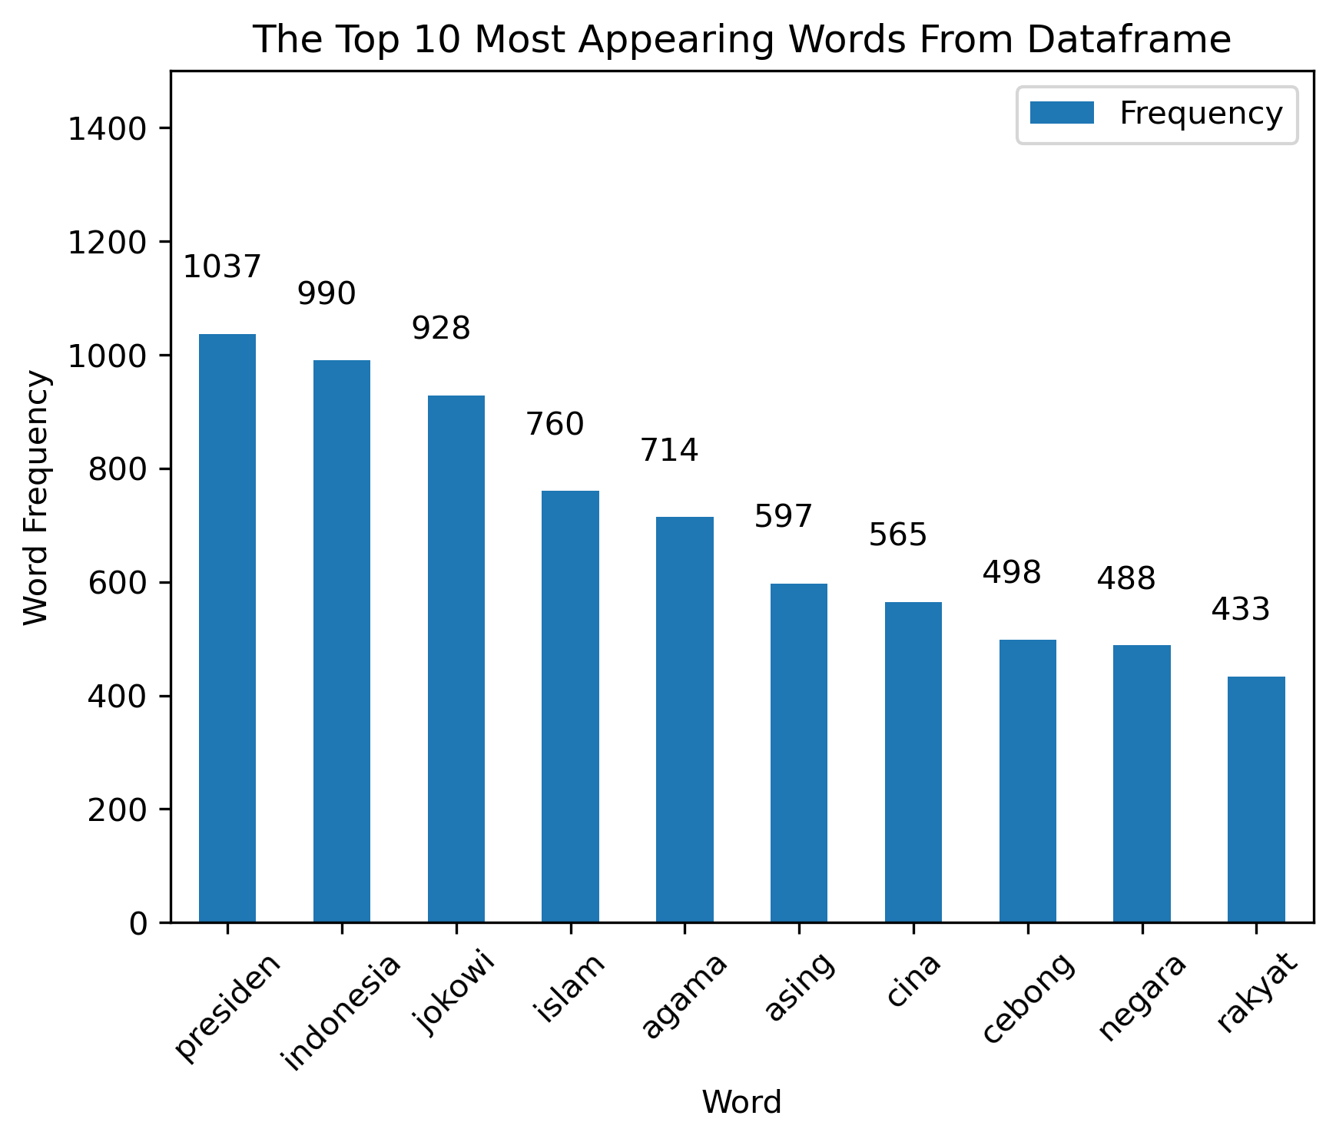
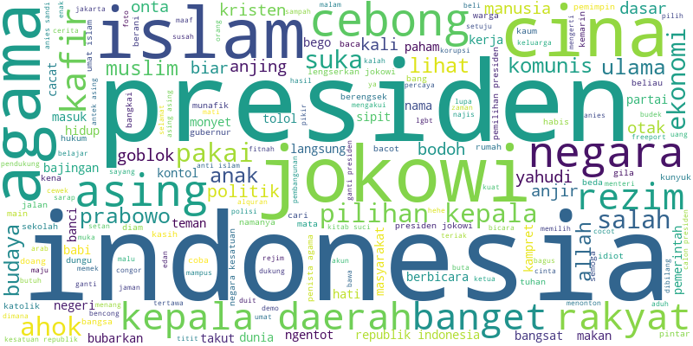
DATA VISUALIZATION
UNIVARIATE ANALYSIS
10 WORDS MOST FREQUENTLY APPEARING FROM INDONESIAN NETIZEN BY WORDCLOUD
10 WORDS MOST FREQUENTLY APPEARING FROM INDONESIAN NETIZEN BY BARCHART MATPLOTLIB

Slide 5
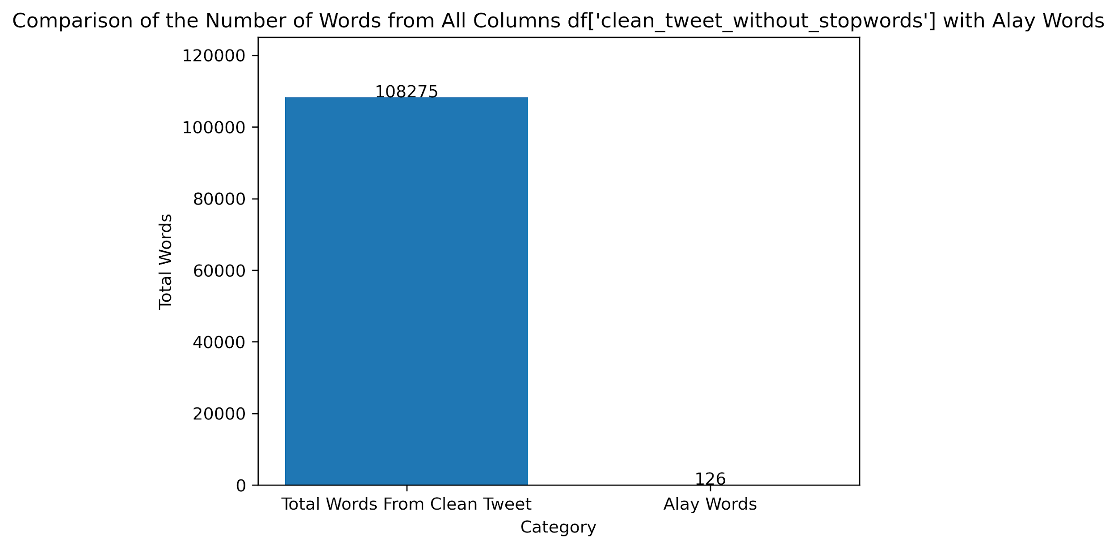
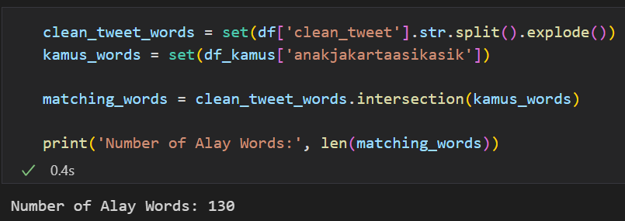
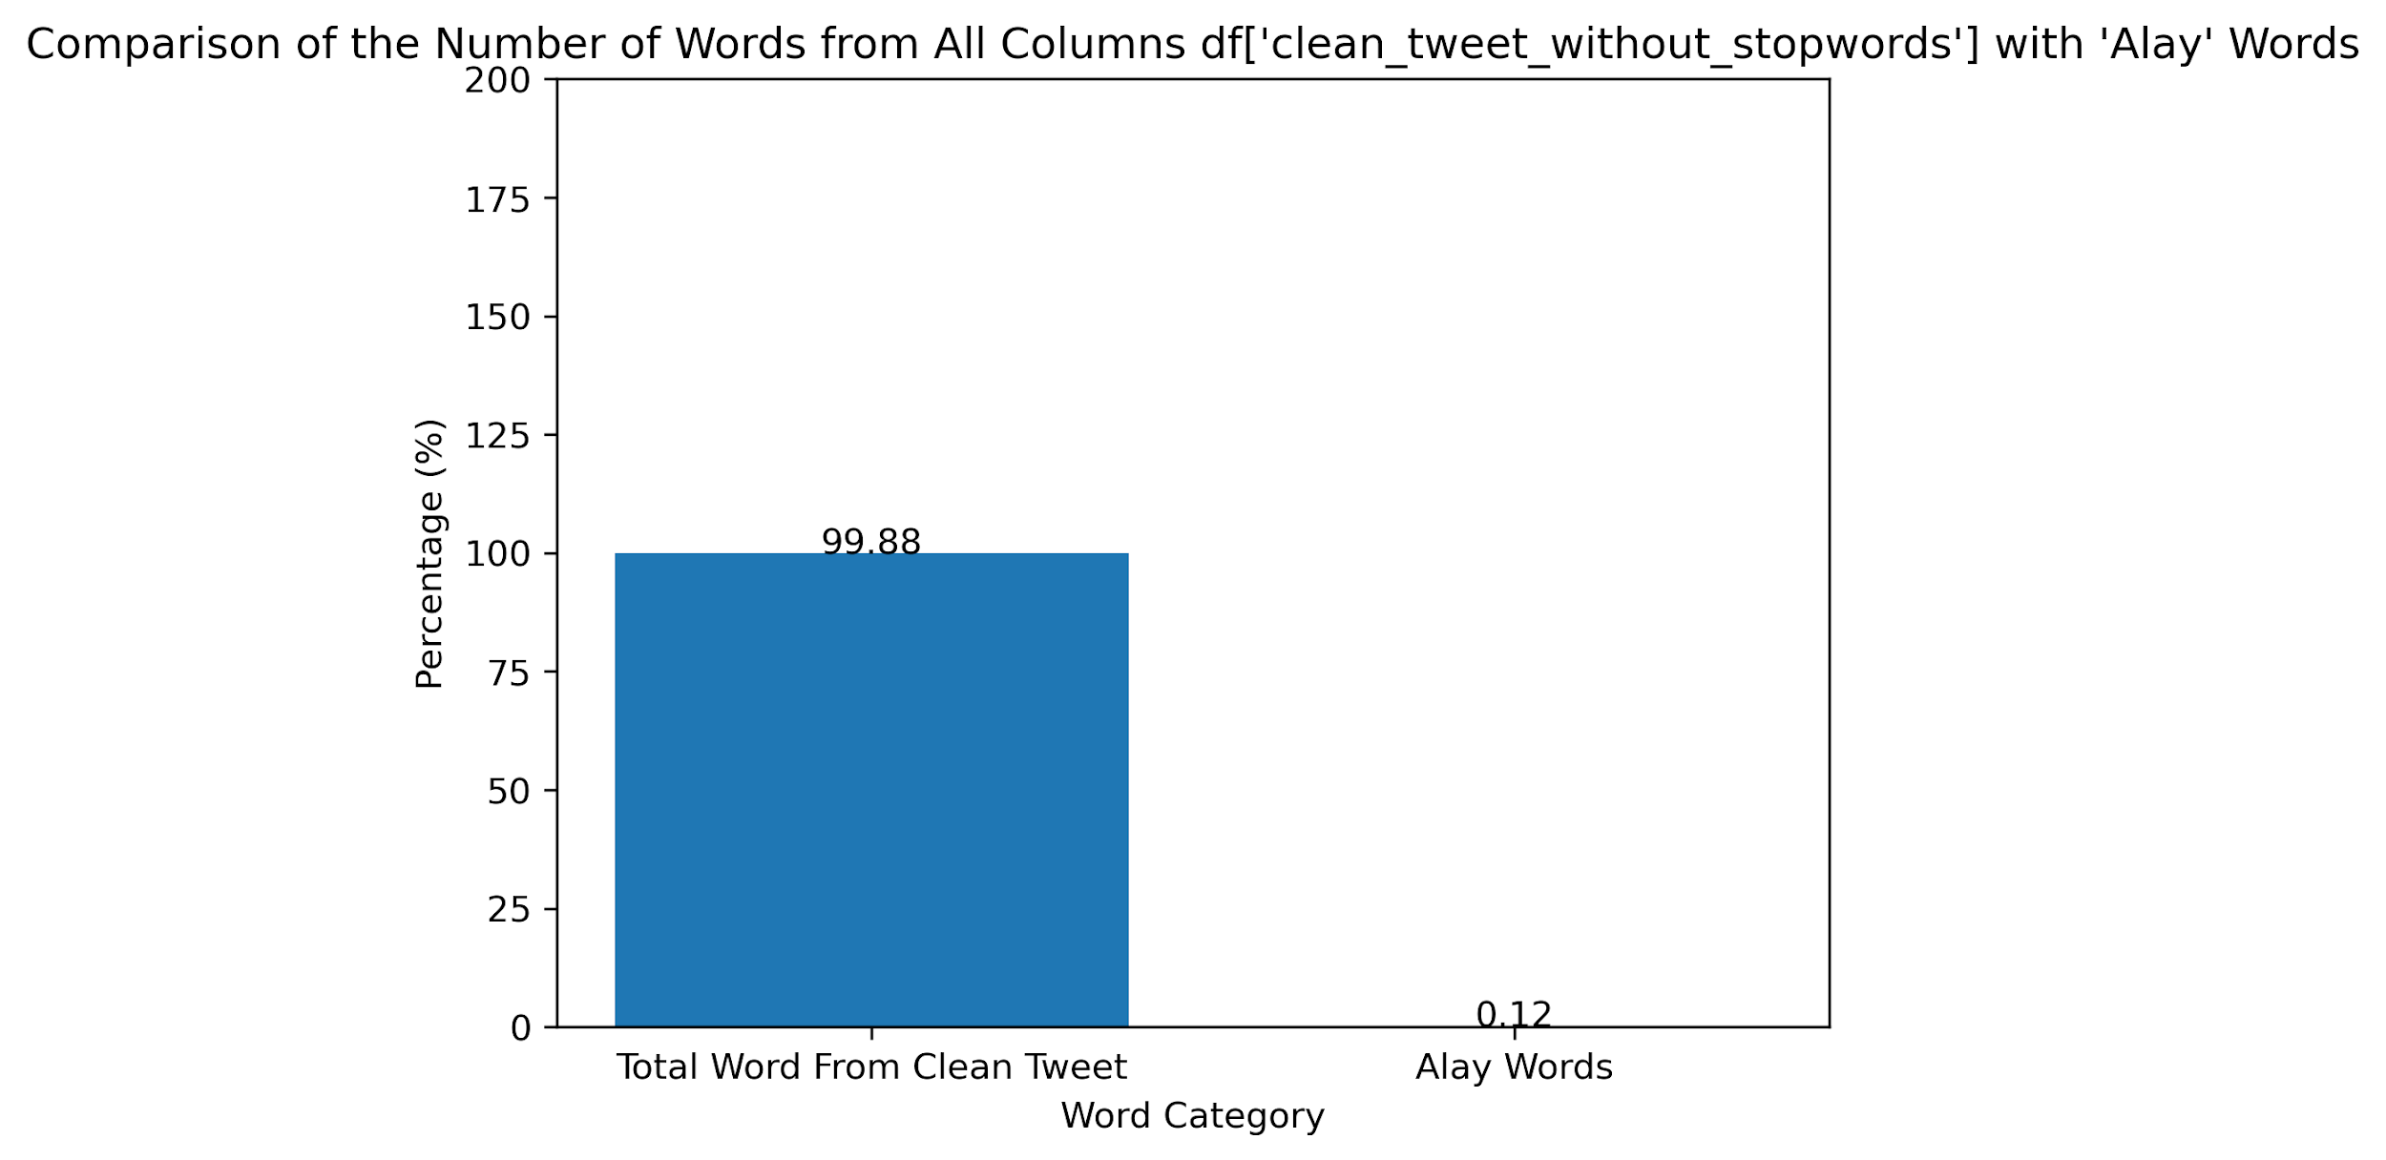
DATA VISUALIZATION
UNIVARIATE ANALYSIS
How Many Alay Words on df['clean_tweet_wo_stopwords'] Based on Words on df_kamus['anakjakartaasikasik']?
To find out the number of alay words contained in column df['clean_tweet_wo_stopwords'], I use the dictionary from new_kamusalay.csv
From the bar chart, I conclude that the word 'Alay' is contained in the data less than the word 'Normal'

Slide 6
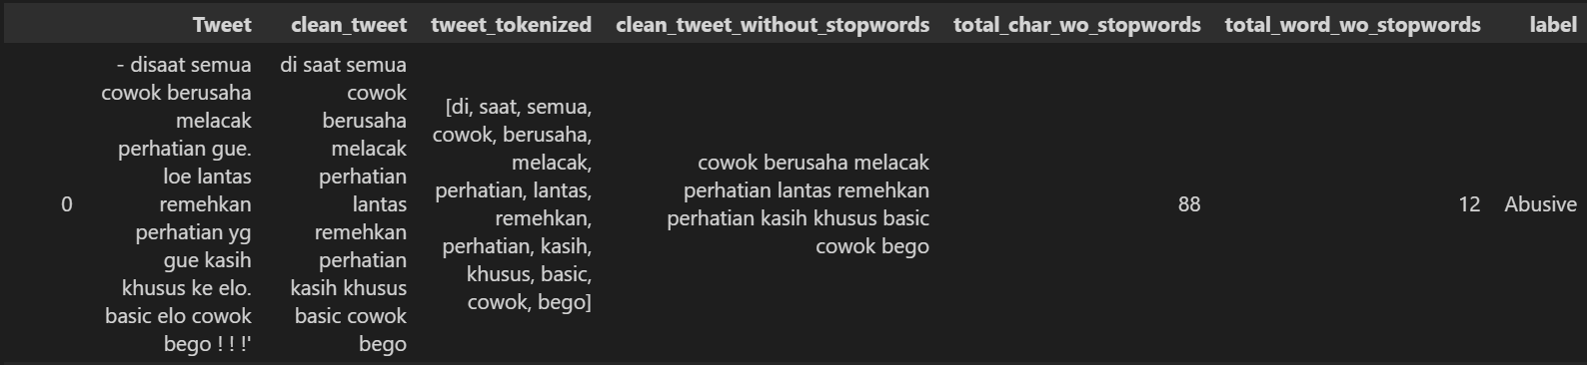
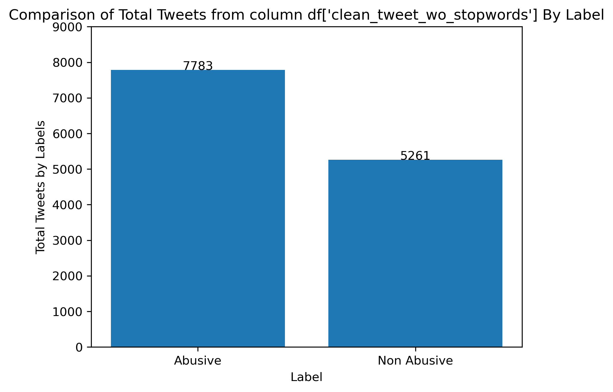
DATA VISUALIZATION
UNIVARIATE ANALYSIS
How many tweets from the data frame are classified as abusive tweets?
To make the label column contain 'Abusive' and 'Non Abusive' in df, I use the file 'abusive.csv' which is defined as df_abusive.
If any words in clean_tweet_without_stopwords column have the same words in df_abusive, the label will being 'Abusive’.
From the bar chart, I can conclude that there are more 'Abusive' tweets than 'Non Abusive'’

Slide 7
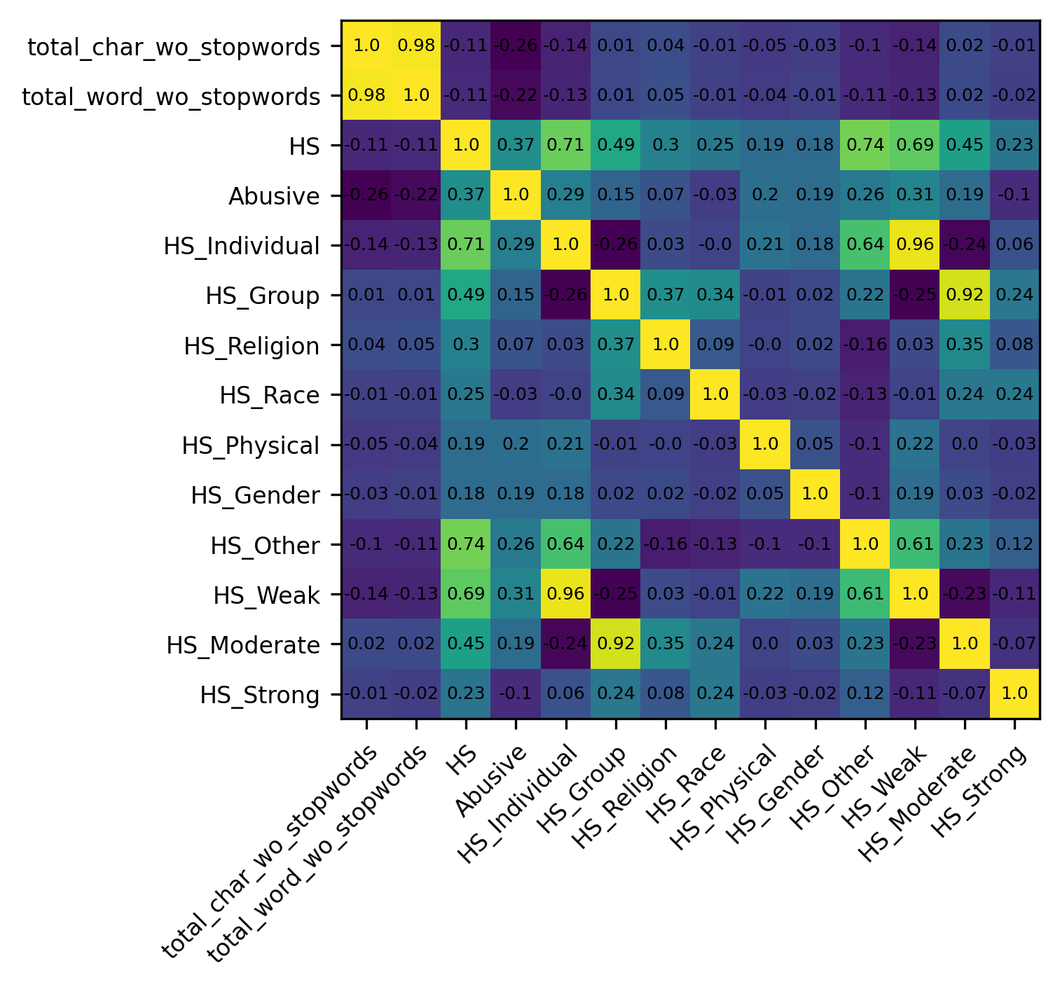
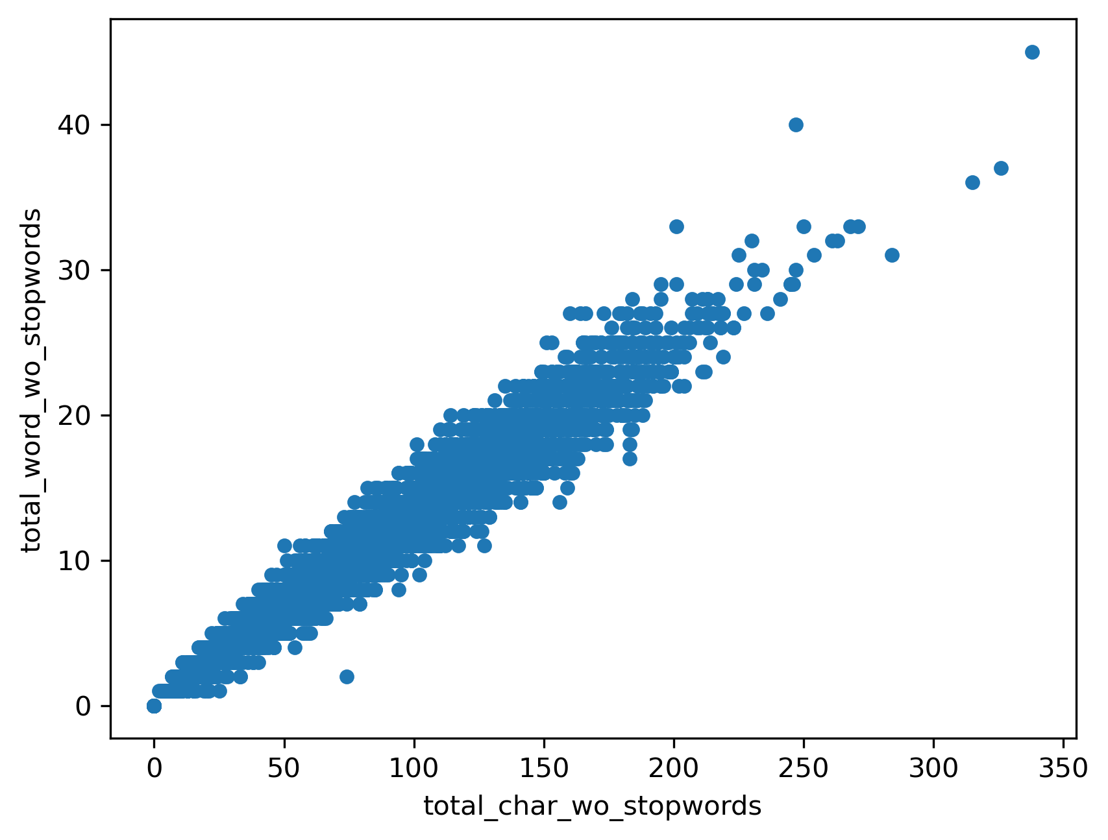
DATA VISUALIZATION
BIVARIATE ANALYSIS
HEATMAP
SCATTER PLOT
Scatter Plot shows the results of a positive correlation between the total characters and the total words.
The 2 variables influence each other, the resulting pattern is linear from the bottom left corner to the top right corner.
From Heatmap Plot, we know that between total_char_wo_stopwords and total_word_wo_stopwords are have positive correlation, because the value is near 1

Slide 8
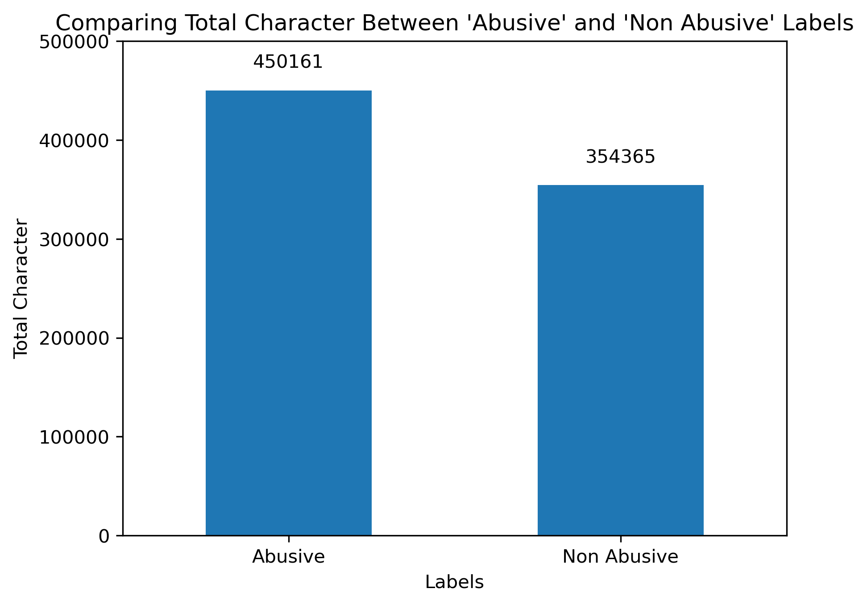
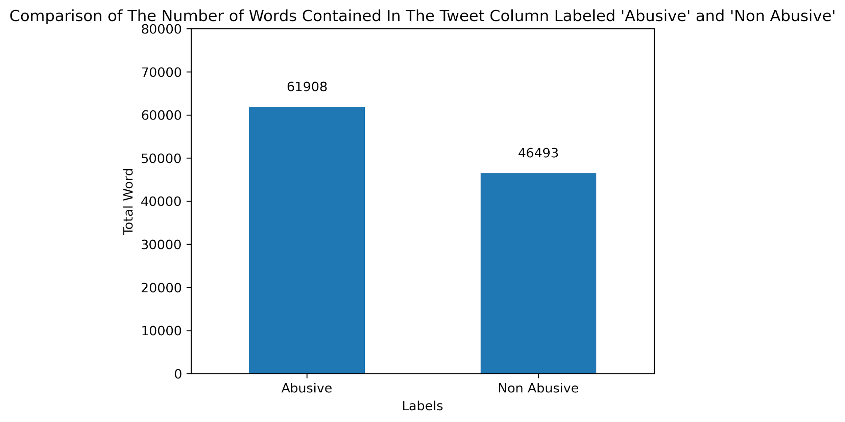
DATA VISUALIZATION
BIVARIATE ANALYSIS
Which is more the number of characters and words between tweet sentences that are classified as abusive and non-abusive?
From the two Bar Charts above, I can conclude that there are more sentences containing 'Abusive' elements than 'Non Abusive' elements written in Tweets by Indonesian Netizens on Twitter.

Slide 9
CONCLUSION
DESCRIPTIVE STATISTICS
MEASURES OF CENTRAL TENDENCY
Mean of total character : 61.68
Mean of total word : 8.31
Median of total character : 53
Median of total word : 7
Mode of total character : 11
Mode of total word : 3
MEASURES OF SPREAD
Range of total character : 338
Range of total word : 45
Q1, Q2, Q3 = [28, 53, 86]
IQR = 58
Variance of total character and total word = [1875.543845, 30.332143]
Standard Deviation of total character and total word = [43.307550, 5.507463]
MEASURES TO DESCRIBE SHAPE OF DISTRIBUTION
Skew of total character and total word :
[1.011451, 0.954882]
The skewness is more than 0, so the skewness is positive
Kurtosis of total character and total word :
[0.945365, 0.775245]
The kurtosis is less than 3, that is show the distribution is producing less outlier value

Slide 10
CONCLUSION
UNIVARIATE AND BIVARIATE ANALYSIS
UNIVARIATE ANALYSIS
BIVARIATE ANALYSIS
The 10 most frequently appearing words in the data sequentially are:
presiden : 1037 words
indonesia : 990 words
jokowi : 928 words
islam : 760 words
agama : 714 words
asing : 597 words
cina : 565 words
cebong : 498 words
negara : 488 words
rakyat : 433 words
The number of words 'Alay' in the data is less than the number of words in the entire data.
There are more sentences containing 'Abusive' elements than 'Non Abusive' elements written in Tweets by Indonesian Netizens on Twitter.
Between the total characters and the total words have a positive correlation.
The number of characters and words from the data is more that has the 'Abusive' category than 'Non Abusive’.

Slide 11
THANK YOU

